Slide 1
Endangered Animals Research Project
8th Grade Science
2016

Slide 2
Resources
www.worldwildlife.org
www.earthsendangered.com
www.arkive.org
www.fws.gov
www.nationalgeographic.com

Slide 3
Important Things to Know
Project and Presentation
DUE no later than
Friday, May 27th
Convince me that I need to care about
the animal you chose.
You must have 4 sources cited.
* 3 can be from internet
* 1 must be from a book
Do your best! Make it neat!

Slide 4
Grading Rubric
Project
Presentation
25 points – Description of animal, environment description, ecosystem support
25 points – 2 environmental changes affects animal, cause of endangered status
20 points – inherited traits, learned behaviors
Total: 70 points
10 points – title, name, date, public service announcement
10 points – eye contact, volume, fluid presentation
10 points – project turned in on or before May 27th
Total: 30 points

Slide 5
Description
Common Name:
Scientific Name:
Which class does it belong to?
What does it look like?
What’s size? Weight?
What physical adaptations has it made to survive?
Year it was put on endangered list?

Slide 6
Environment
Where does it live (found where?)?
Describe it’s habitat
What’s the climate (biome)?
Is it’s habitat in danger? Why?
Pick 2 environmental changes such as floods, droughts, fires. Would they cause your animal to thrive (survive well), perish (die), or move? Explain why

Slide 7
Reproduction
How many babies does it usually have?
Are their babies in danger? How? Why?
What’s the current population of your animal?
How long does it typically live?

Slide 8
Eating Habits
What does it eat?
Where does it find it’s food?
How does it find/get its food? (Hunt?)
Is your animal prey to another? If yes, what animal?

Slide 9
Endangered Facts
Why is your animal endangered?
What will happen if your animal becomes extinct?
Who/what is effected if it’s extinct?
What’s being done to prevent extinction?
How can I/we help prevent extinction?

Slide 10
Interesting Facts
Does it travel alone? In groups?
Is it nocturnal?
Do they live in the wild or in captivity or both?
What are some of the inherited traits?
What are some learned behaviors?

Slide 11
Things to include
Map of where it’s found
Pictures of the animal

Slide 12
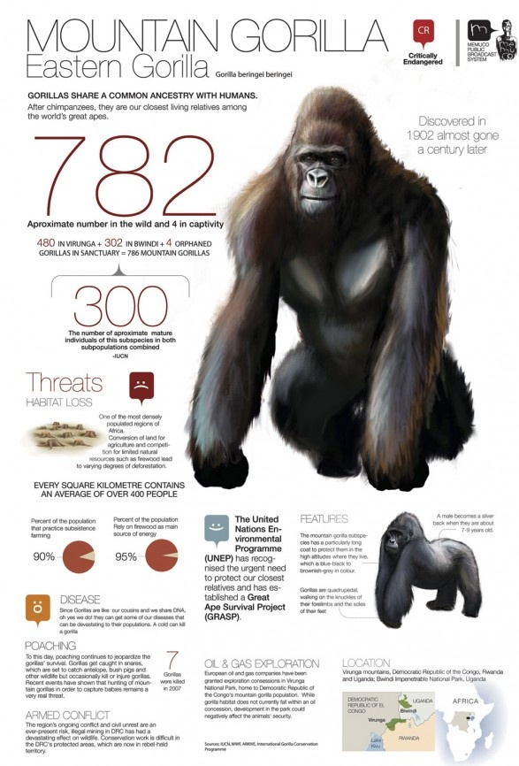
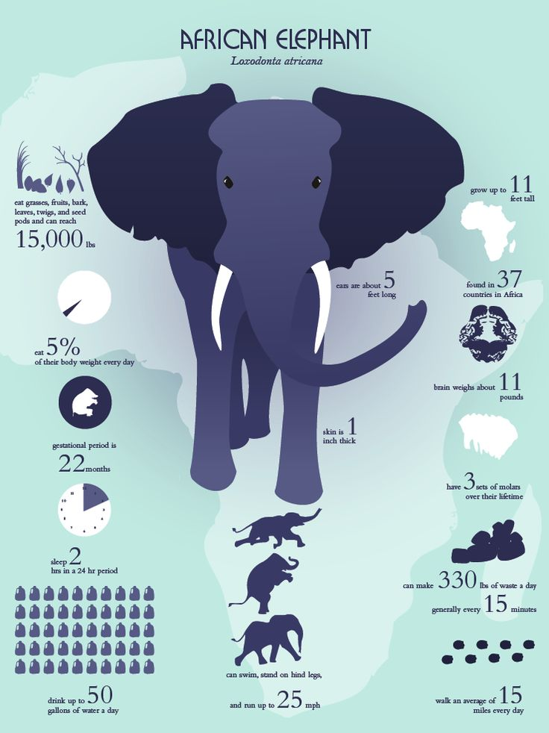

Slide 13
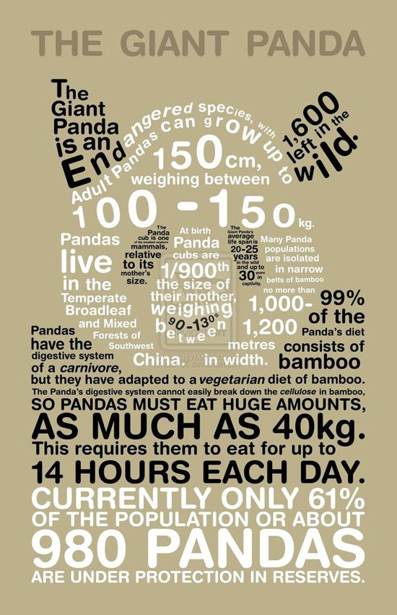
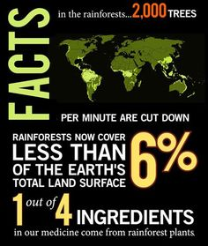

Slide 14
